Slide 1
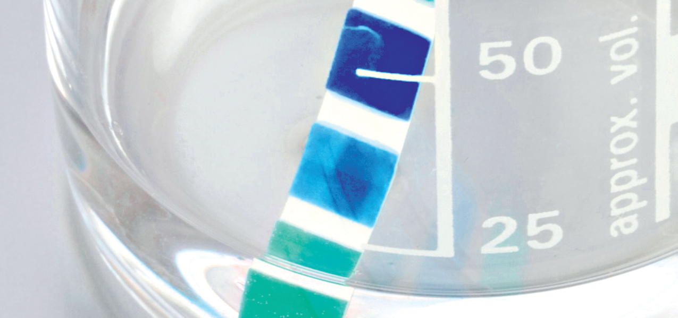
Chapter 7:
Reactions in aqueous solutions

Slide 2

Aqueous solutions of ionic compounds
Can be classified as:
Soluble
> 10g solute L⁻¹
Insoluble
less than 1 gL⁻¹
Sparingly soluble
Between 1gL⁻¹ to 10gL⁻¹

Slide 3
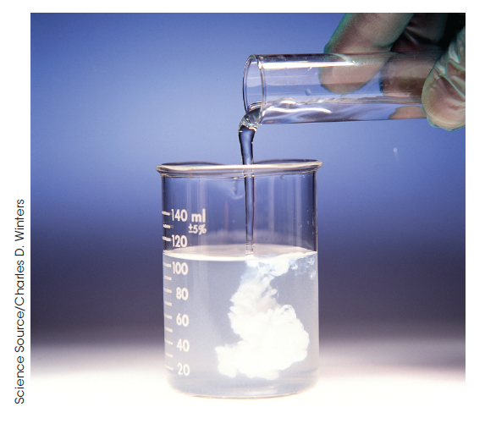
Precipitation reactions
A precipitate is a solid produced by the reaction between two clear solutions.
.

Slide 4
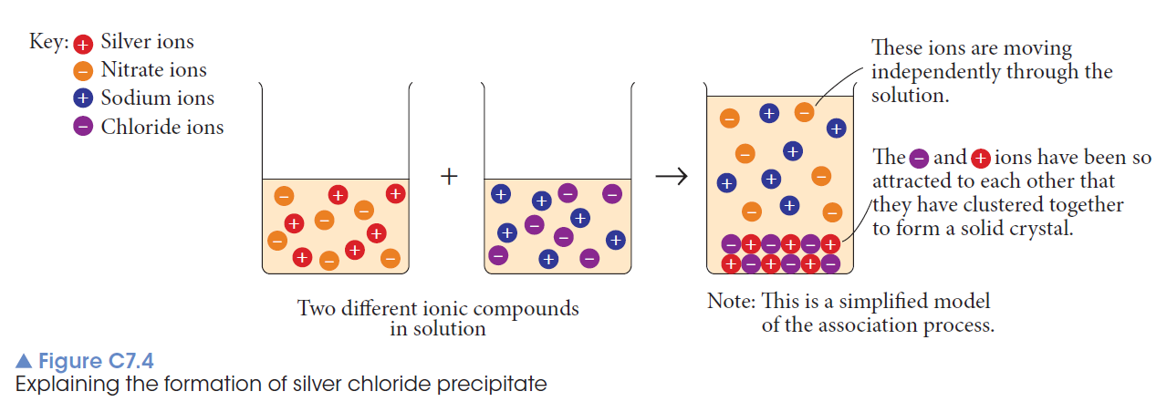
Sodium chloride is added to a silver nitrate solution.

Slide 5
Complete ionic equation
Na⁺(aq) + Cl⁻(aq) + Ag⁺(aq) + NO₃⁻(aq) →
AgCl(s) + NaNO₃(aq)
Shows all ions present
Net ionic equation
Ag⁺(aq) + Cl⁻ (aq) → AgCl(s)
The spectator ions Na⁺ and NO₃⁻ not shown.

Slide 6
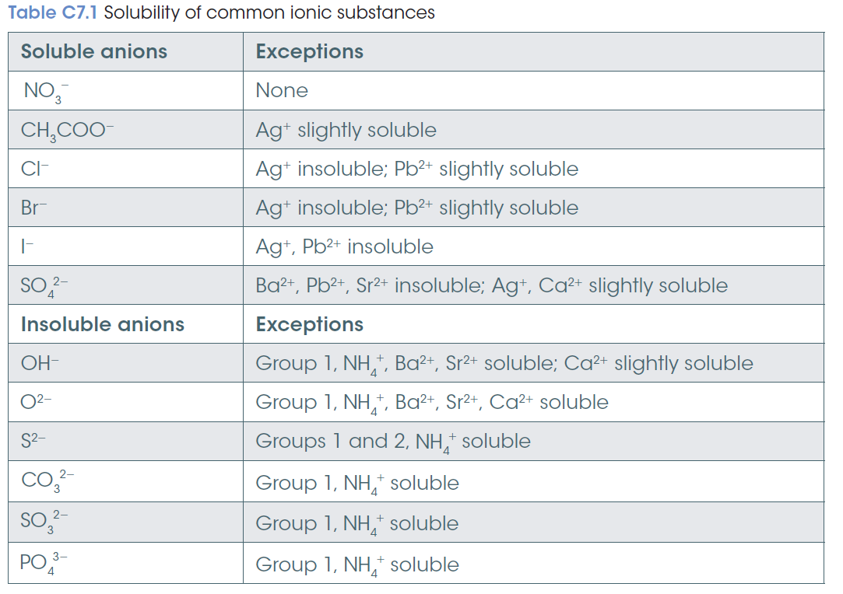

Slide 7
Determining concentration
The concentration of a solution is the amount of solute present in a specified amount of solution.
% w/w, % v/w, % w/v and ppm

Slide 8
Molarity
The measure of concentration in terms of moles is called molarity.
The molarity of a solution is defined as the number of moles of solute per litre of solution.
c = n/V
Concentration (mol L⁻¹)
= number of moles of solute (mol)
volume of solution (L)

Slide 9
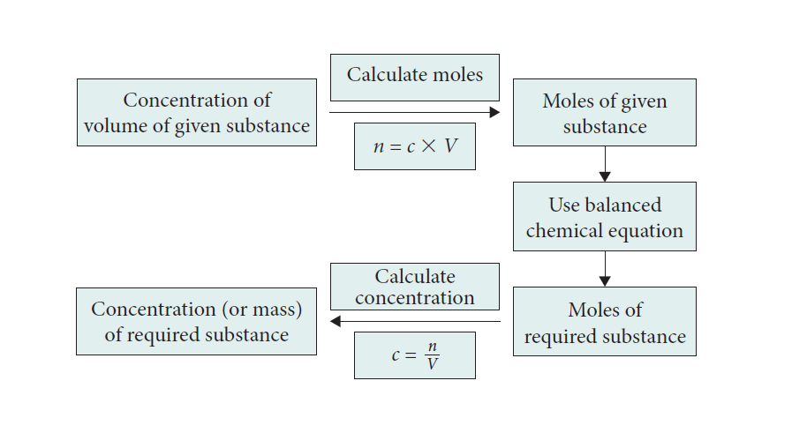

Slide 10
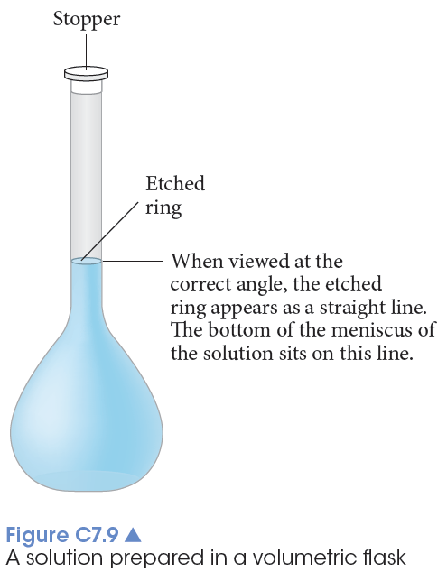
Laboratory preparation of a solution
Weigh the solute and transferred to a volumetric flask.
Rinse the solute’s beaker with distilled water and transfer to the volumetric flask.
Dissolve the solute with distilled water and then make up to the calibration mark.
The stopper is placed in the flask, which is inverted several times to ensure through mixing of the solution.

Slide 11
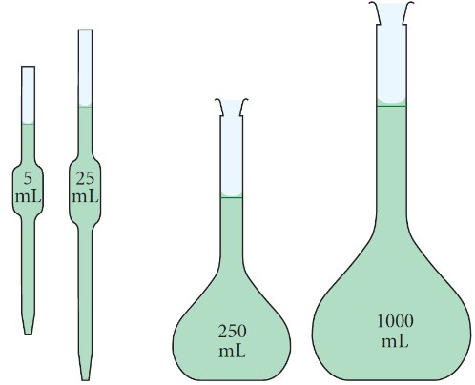
Dilutions
The process of adding water to a solution to make it less concentrated
Dilution procedure:
Use a pipette to measure a definite volume of a solution of known concentration.
Transfer this volume to a volumetric flask.
Add sufficient water to the volumetric flask to make up the solution to the calibration mark.

Slide 12
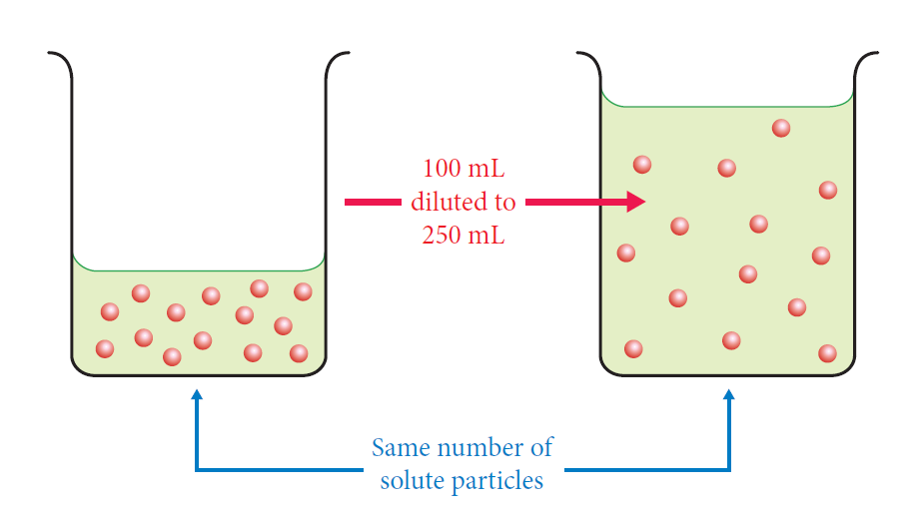
To calculate the concentration of the diluted solution, we use the fact that the number of moles (particles) in the diluted solution is the same as in the original volume of solution.

Slide 13
Calculations
c₁V₁ = c₂V₂
where c₁ and c₂ are the initial and final concentrations of the solution in the same units.
V₁ and V₂ are the initial and final volumes of the solution, in the same units.

Slide 14
Acids and bases
An acid
produces hydrogen ions, H⁺, in aqueous solution.
hydronium ions, H₃O⁺
A base
either contains the oxide O²⁻ or hydroxide ion OH⁻ or produces hydroxide ion in aqueous solution.
A soluble base is called an alkali.

Slide 15
Common properties of acids include:
a sour taste
sting or burn the skin
conduct electricity in solution
turn blue litmus red
Common properties of bases include:
a slippery feel in aqueous solution
a bitter taste
conduct electricity in solution
turn red litmus blue

Slide 16
Amphoteric oxide
Not all oxides are basic.
Most oxides formed between a non-metal and oxygen (for example CO₂ and SO₃) are acidic or
Neutral.
Those formed between a metal and oxygen.
For example CaO and MgO are basic
or amphoteric (acting as either an acid or a base.)

Slide 17
Acid base reactions
Acid and bases react to form compounds called salts and water.
This neutralisation reaction can be written as
Acid + base → salt and water
eg HCl(aq) + NaOH(aq) → NaCl(aq) + H₂O(l)

Slide 18
Indicators and pH
Indicators can also provide information on the degree of acidity or alkalinity.
A more precise scale to measure the concentration of acid in a solution is called the pH scale.

Slide 19
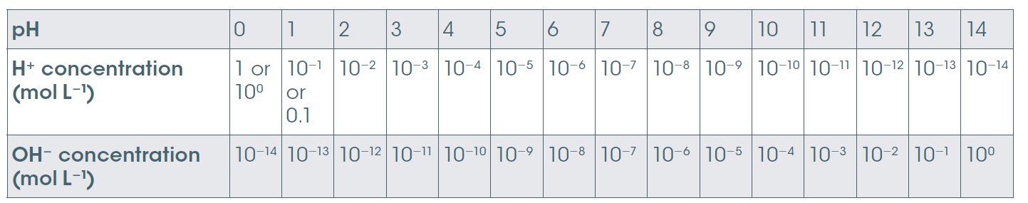
pH scale
The pH scale is based on the concentration of hydrogen ion in solution.
It provides a measure of the acidity or alkalinity.
pH < 7 acidic, pH = 7 neutral, pH > 7 basic
Note 1 pH unit change = 10 x change in concentration

Slide 20
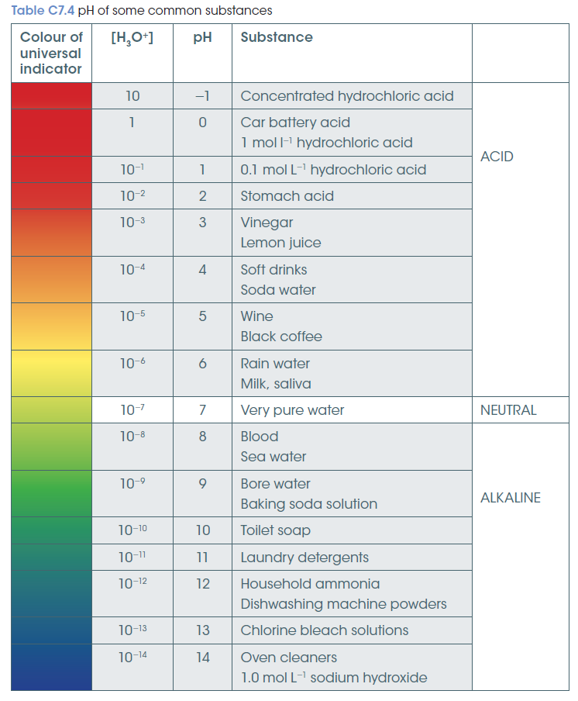
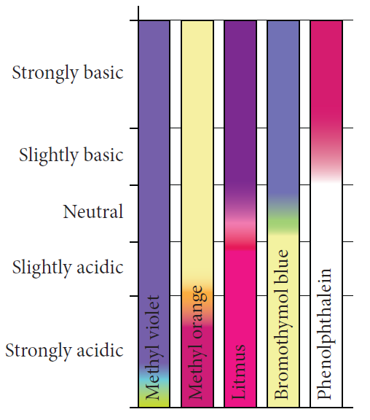
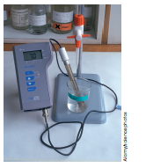
Measuring pH
pH measured by
Indicators change colour at various pH values
& pH meters.

Slide 21
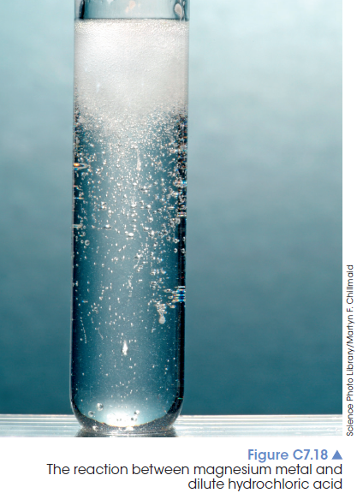
Reactions of acids
Acid + metal → salt + hydrogen gas
2HCl(aq) + Mg(s) → MgCl₂(aq) + H₂(g)

Slide 22
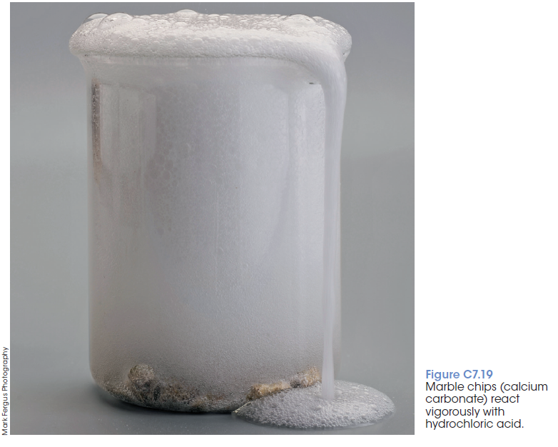
Acid + carbonate →
salt + carbon dioxide + water
2HCl(aq) + CaCO₃(s) → CaCl₂(aq) + H₂O(l) + CO₂(g)

Slide 23
Acid + hydrogen carbonate →
salt + carbon dioxide + water
HCl(aq) + NaHCO₃(s) → NaCl(aq) + H₂O(l) + CO₂(g)

Slide 24
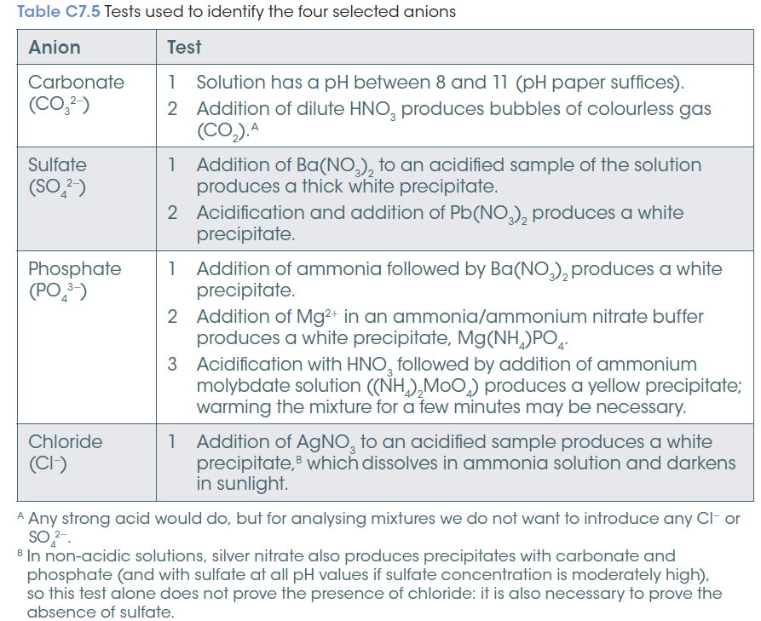
Identifying unknown ions in solution

Slide 25
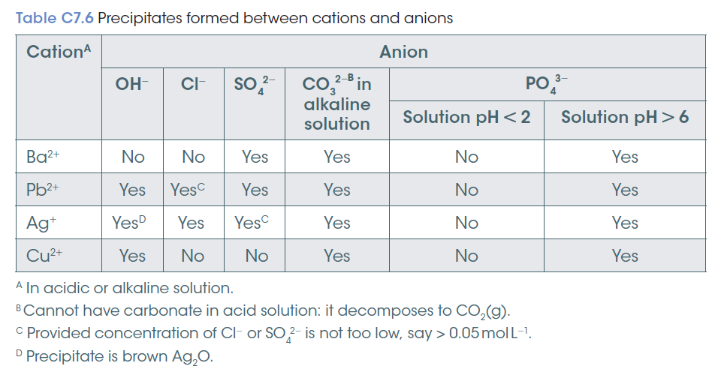

Slide 26
